Slide 1
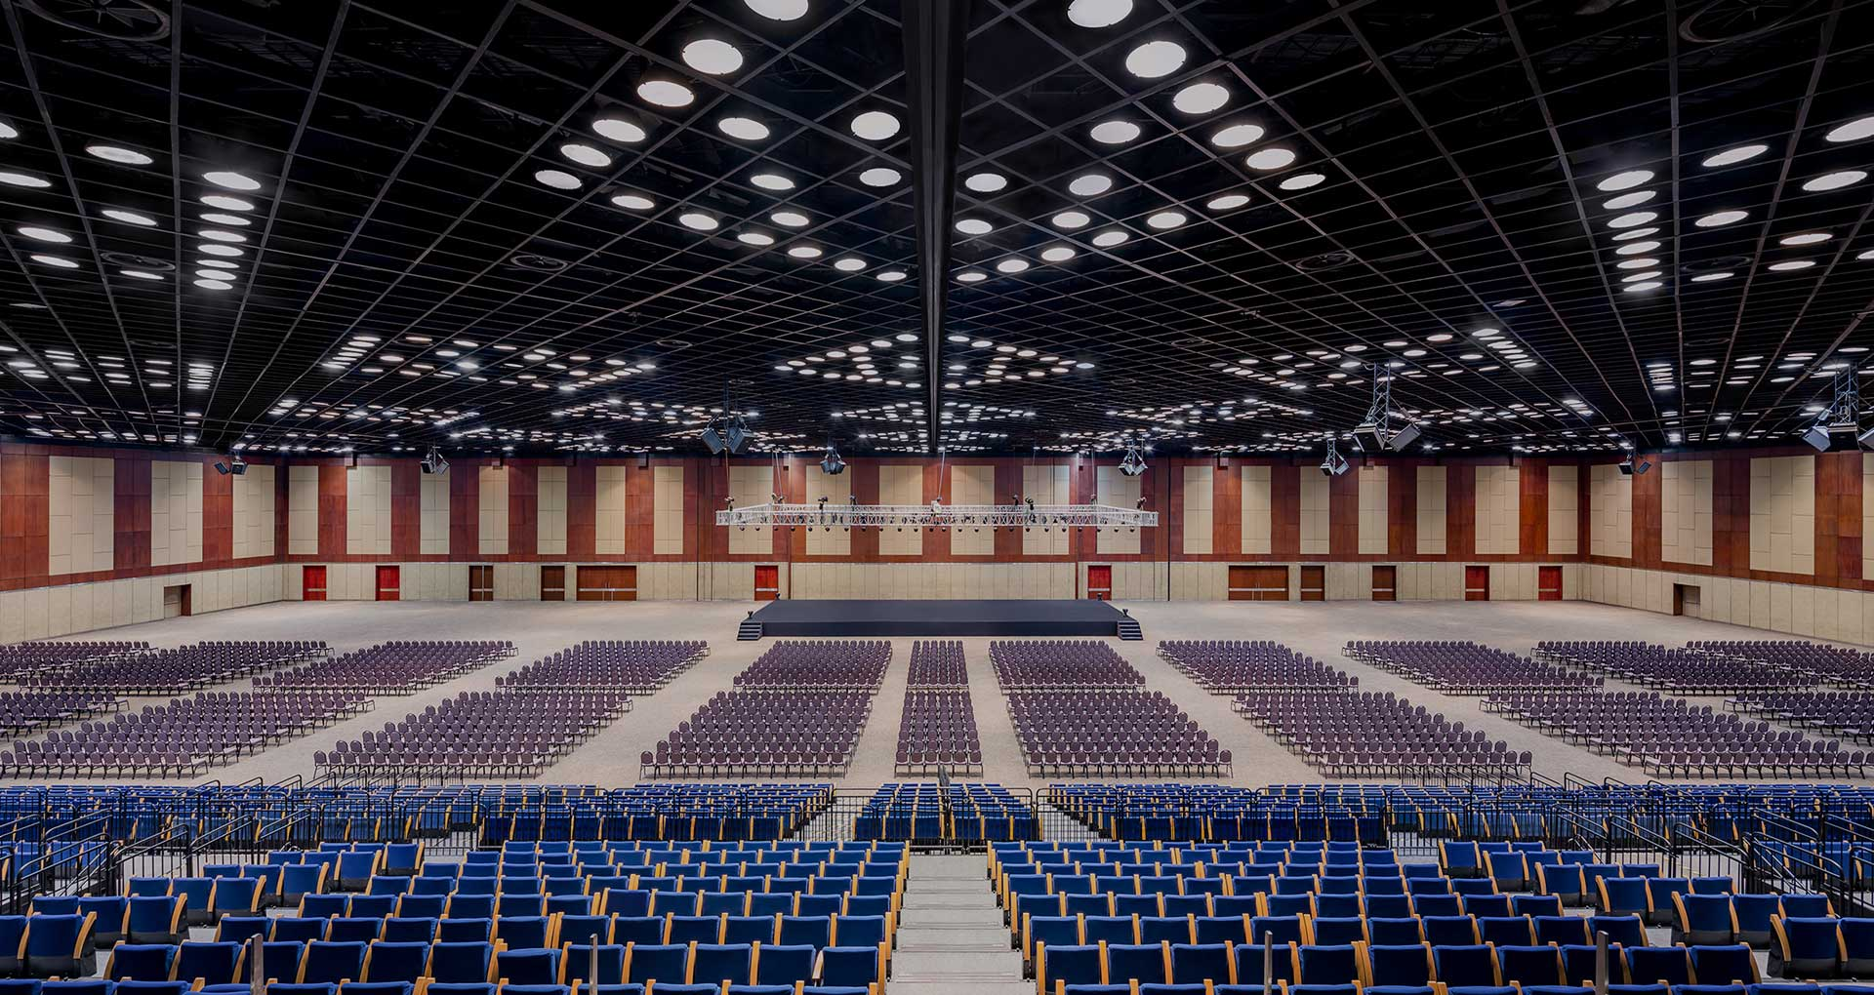
November, 2022
Haryana: Future Destination for MICE Tourism & Festivals
By:
Haryana Tourism Department
Government of Haryana

Slide 2
Potential of Haryana to become country leader in convention centre
Location Advantage
Infrastructure
Well developed National & State highway connectivity.
Access to world class Hospital, Hotel and entertainment infrastructure in a liberal location
Ease of doing events from statutory perspective
Supportive government policies towards tourism and events
Delhi/NCR is the hub of economic growth for country.
Gurgaon is well established IT hub and already on world map.
Close driveable proximity to tourist designation like Agra, Jaipur, Kurukshetra makes its ideal for after convention activities.
Haryana
Cultural Advantages
Surujkund Mela, Asia 2nd biggest cultural event
Historical places of Kurukshetra, Panipat, etc
Rich confluence of History and modern demographic
Air Connectivity
Presence of 3 Major international Airports
India’s busiest Airport of Delhi (26 Km) & Chandigarh Airport
Upcoming Jewar Airport (70 Km)in NOIDA makes it’s high potential convention destination.

Slide 3
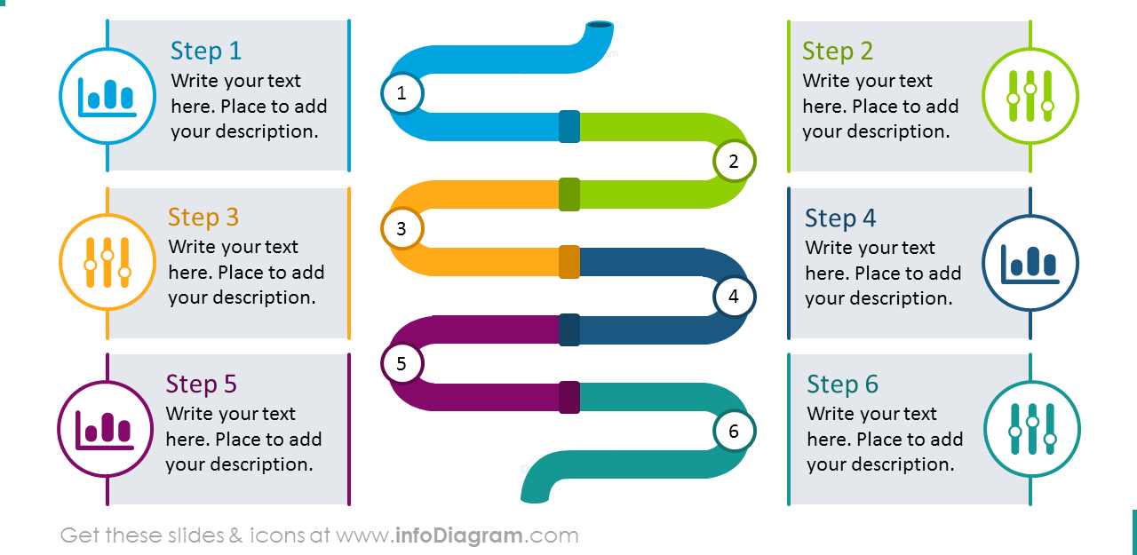
Haryana Government Vision and Objective
Economic And Employment Generation.
Training and Capacity Building
To promote MICE tourism as a major engine of economic growth and capitalize the potential thereby generating Employment
To enhance professional excellence in training human resources and providing upliftment of Standard of Life
Untapped Potential
Promotion & marketing
Promote Haryana as a tourist destination to take advantage of the global travel trade & develop untapped potential of MICE Tourism of Haryana.
Developing sustained and effective Promotion , marketing strategy and plan
Private Sector Participation
Technology advancement
To acknowledge the critical role of private sector in development of tourism and services
Use of technology and IT solutions and dashboards for integrated monitoring of systems
Leasing out of HTC properties and Convention facilities on PPP Mode to boost MICE Tourism

Slide 4
Banquet Halls and Convention Facilities
Parakeet Tourist Complex
Red Bishop Tourist Complex
Banquet Hall
Banquet Hall (2 Nos)
Capacity: 300-500 Pax.
Capacity: 300-500 Pax. Each
1755 Sqm Built up
Panchkula
1620 Sqm Built up
Koel Tourist Resort
Kingfisher Tourist Complex
Convention Hall
Ambala
Banquet Hall
Capacity: 300-500 Pax.
Capacity: 300-500 Pax.
Yamuna
Nagar
2240 Sqm Built up
500 Sqm Built up
Kurukshetra
Grey Pelican
Surkhab Tourist Complex
Banquet Hall
Banquet Hall
Capacity: 400 Pax.
Capacity: 200 Pax.
Karnal
1190 Sqm. Built up
700 Sqm. Built up
Kaithal
Sirsa
Fatehbad
Oasis Tourist Complex
Flamingo Tourist Complex
Jind
Banquet Hall
Banquet Hall
Panipat
Capacity: 400 Pax.
Capacity: 400 Pax.
Hisar
1870 Sqm. Built up
1950 Sqm. Built up
Sonipat
Baya Tourist Resort
Rohtak
Skylark Tourist Complex
Convention Hall
Bhiwani
Banquet Hall
Capacity: 400 Pax.
Capacity: 300 Pax.
1200 Sqm. Built up
Charkhi Dadri
Jhajjar
1127 Sqm. Built up
Tilyar Tourist Complex
Gurgaon
Magpie Tourist Complex
Convention Center
Rewari
Silver Jubilee Convention Hall
Capacity: 400 Pax.
Capacity: 500 Pax.
2300 Sqm. Built up
2300 Sqm Built up
Mewat
Palwal
Gauriyya Tourist Resort
Jungle Babbler
Hotel Rajhans
Convention Hall
Convention Hall
Convention Center and Ground
Capacity: 400 Pax.
Capacity: 200 Pax.
Capacity: 600 Pax.
680 Sqm. Built up
350 Sqm. Built up
2127 Sqm Built up

Slide 5
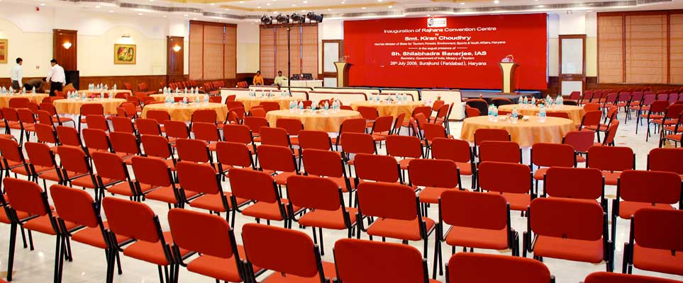
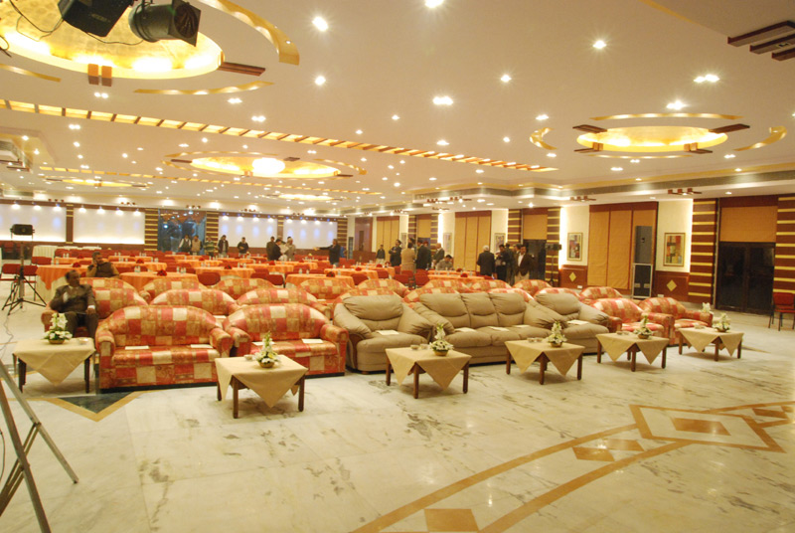
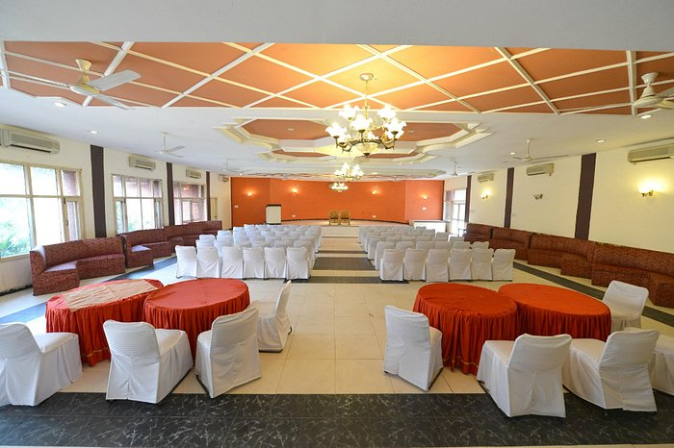
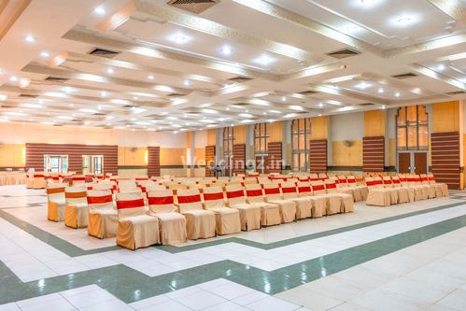
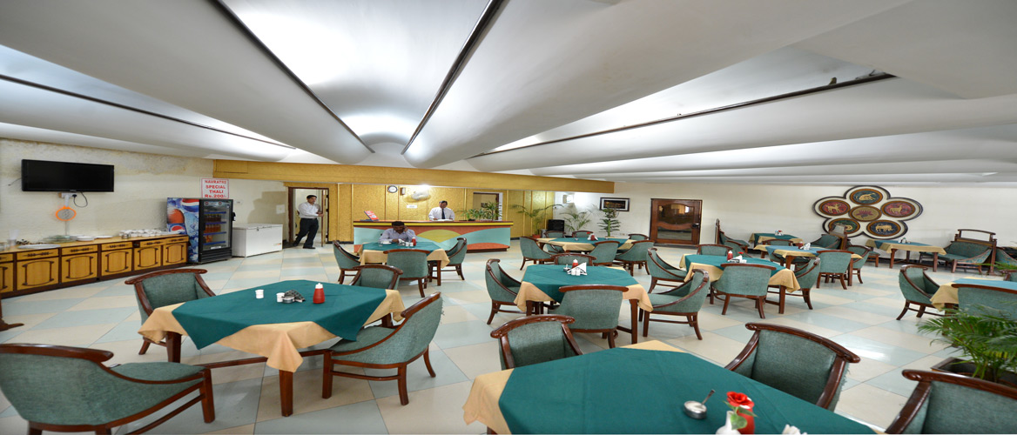
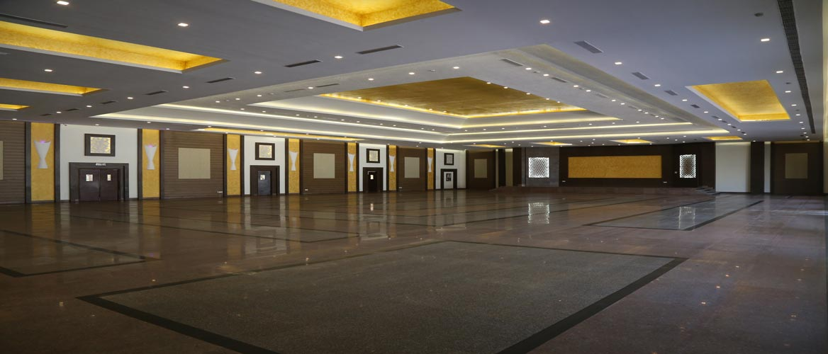
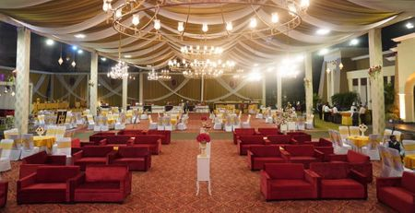
Top Performing Banquet Halls and Convention Centers
Owned and Run by HTC
Rajhans Tourist complex, Surajkund
Tilyar Lake, Rohtak
Kingfisher Tourist Complex, Ambala
Red Bishop, Panchkula
Surkhab Tourist Resort, Sirsa
Magpie Tourist Complex
Grey Pelican, Yamuna Nagar

Slide 6
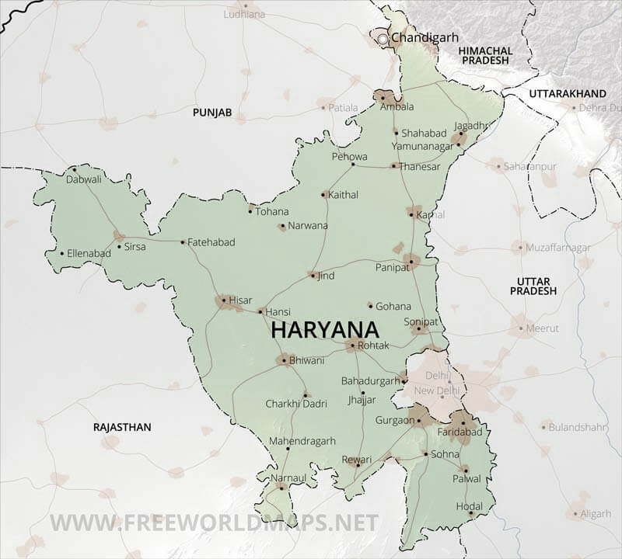
Major MICE Destinations in Haryana
Pinjore and Tikkar Taal - Hot Air Ballooning activity and Festival at Pinjore and Morni Hills
Panchkula
Morni Hills Kausalya Dam
Pinjore Gardens
Chandigarh
Mata Mansa Devi Temple
Yamuna Nagar
Adi Badri
Lohgarh
Kalesar
Jagadhri
Shahabad
Adventure Activity at Hathnikund Barrage and Kausalya Dam along with International Adventure activities Festival.
Haryana State is proactive in promoting MICE as a major Tourism industry with its initiatives through Hub and Spoke Model development.
Suraj Mela was initiated in 1987 to promote handicrafts
Acts as a platform to bring global artisans under one roof
The Shanghai Cooperation Organization (SCO) will participate as the Partner Nation in upcoming 36th Edition of Surajkund Mela
Faridabad/ Gurgaon
Surajkund
Aravali Golf Course
Sohna
Damdama Lake
Nahar Singh Mahal
Kingdom of Dreams
Sultanpur sanctuary
Damdama lake
Upcoming Cultural District Leisure valley Park
Gurgaon &Faridabad attracts Maximum number of business meetings and events.
Haryana Tourism has been very proactive in projecting the state as a pertinent center for MICE. Aravali Golf Course will be hub for Sports related MICE activities
State is in the process of constructing & Convention Center in Faridabad
Mahendragarh
Madhogarh Fort
Narnaul
Jal Mahal
Sky Diving and Paragliding festival at Narnaul, Mahendragarh, 2023 to be happening
Hisar
Rakhigari
Baradari
Hansi Gate
Flamingo Convention
Development of Museum, Convention and OAT at Rakhigari in Hisar which will strengthen MICE Activities in Hisar

Slide 7
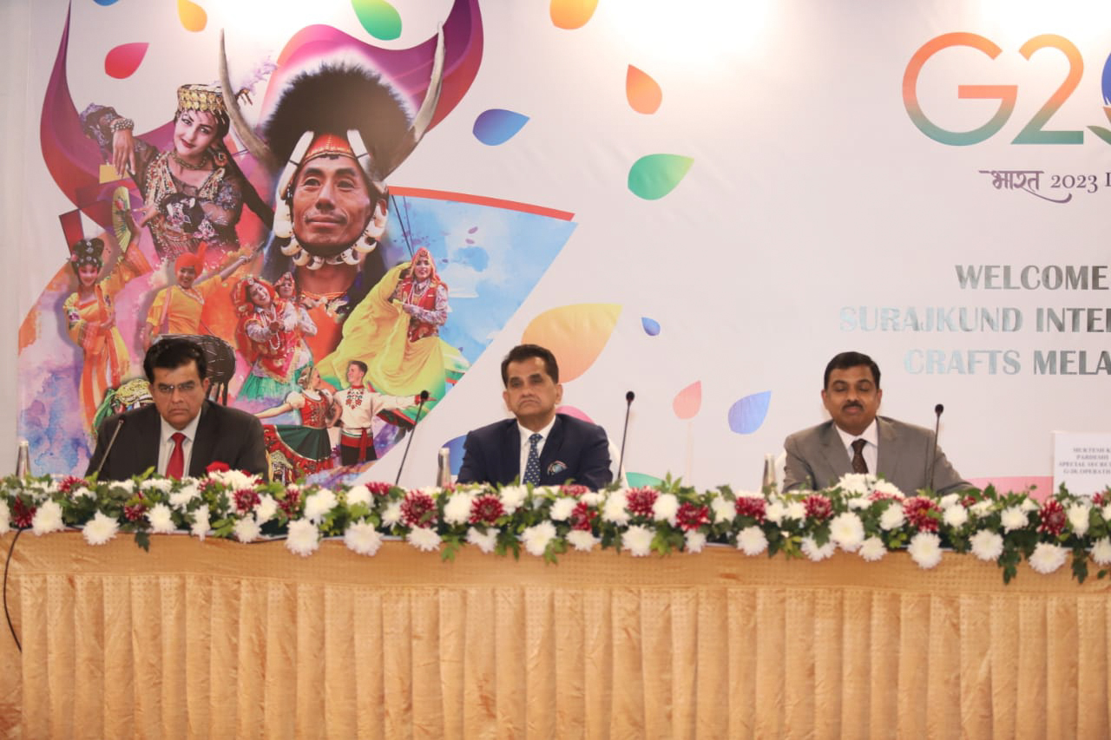
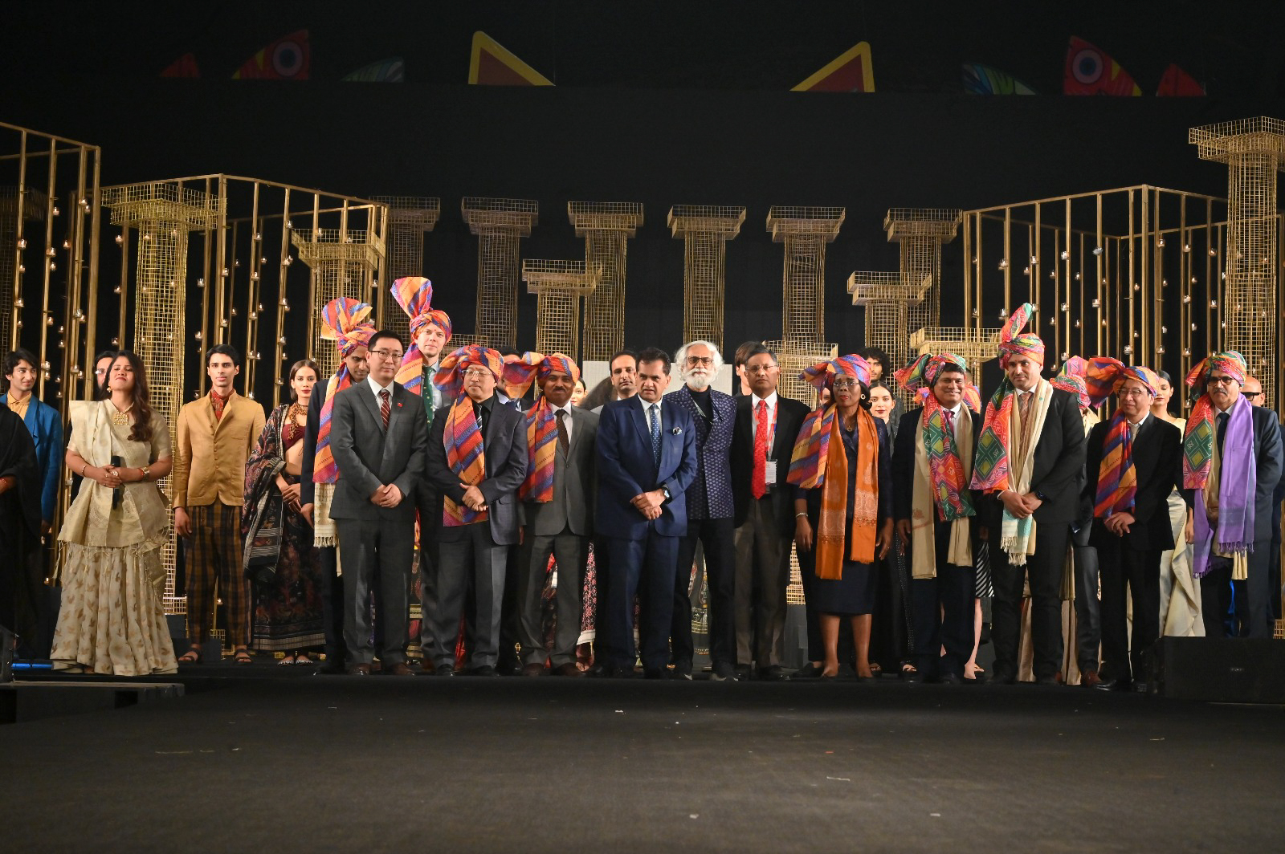
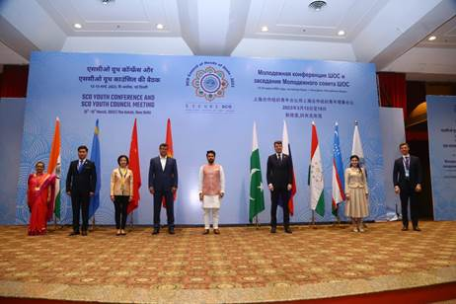
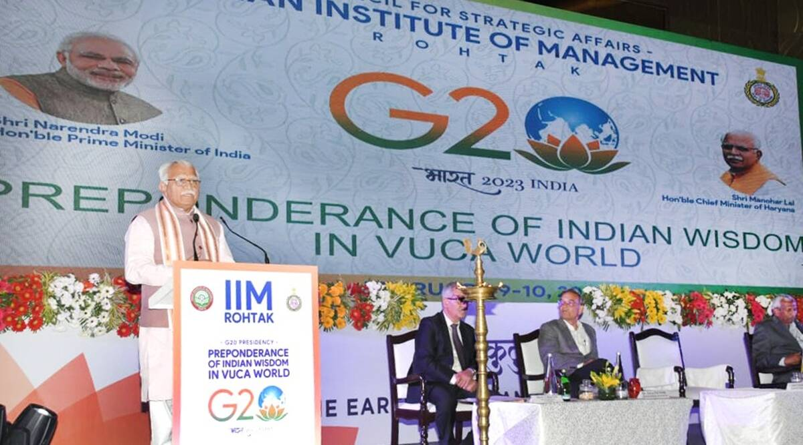
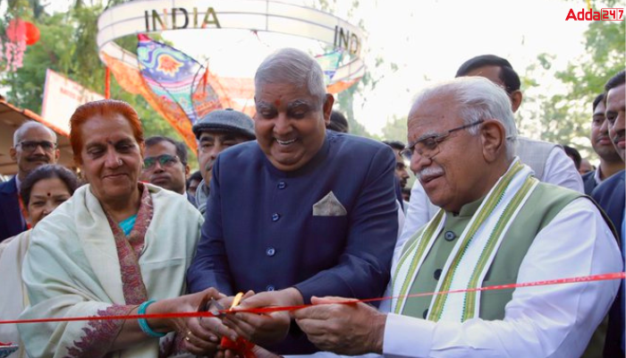
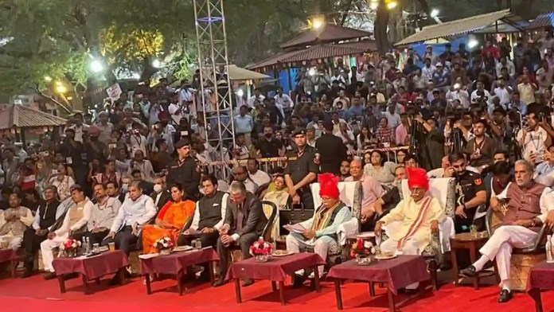
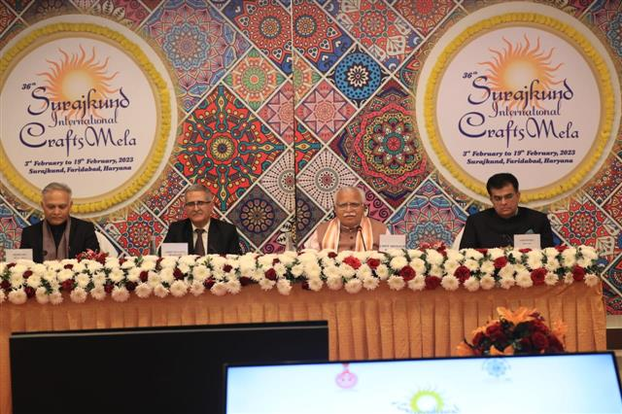
Major MICE Activities Held on the sideline of Surajkund Mela, 2023
The 36th Edition of the Surajkund International Crafts Mela is poised to write history as it witnessed an unprecedented participation by foreign countries in a large number.
Along with SCO (Shanghai Cooperation Organization) asa partner nation and various other international meetings, Surajkund mela also hosted various other meeting with all G20 Delegates in Faridabad.

Slide 8
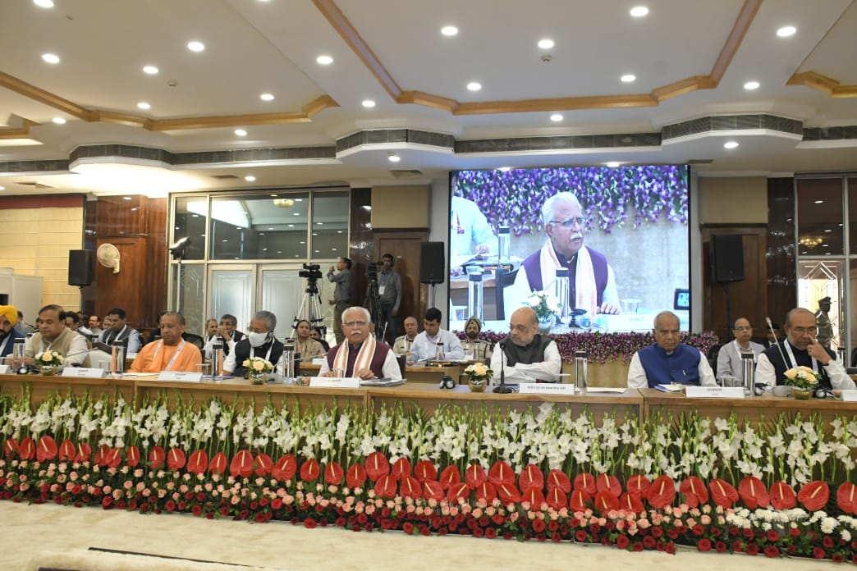
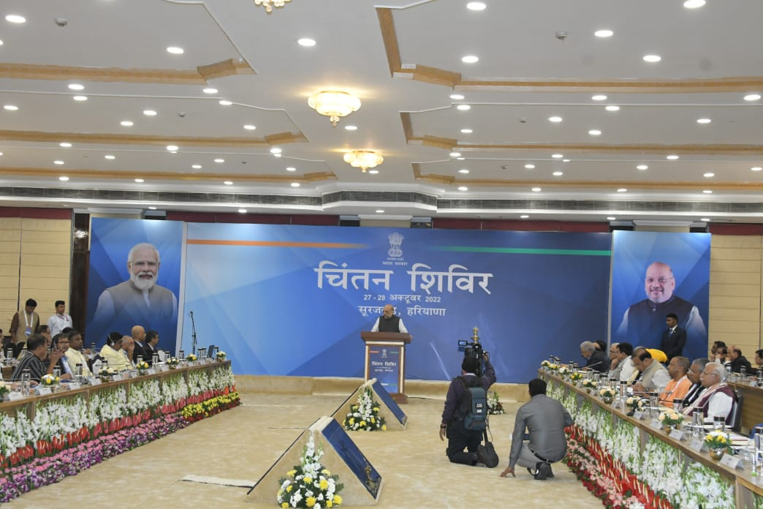
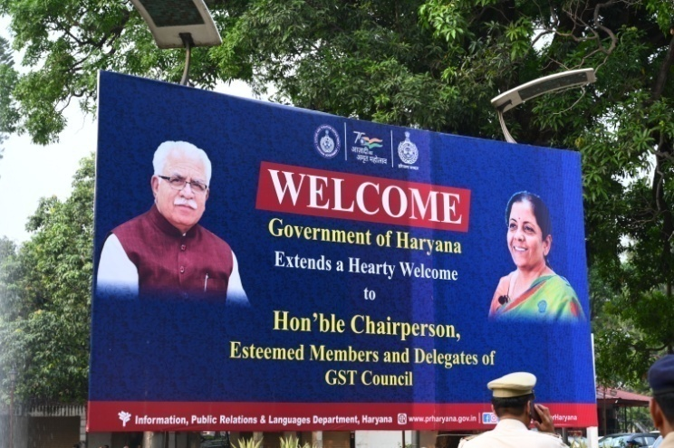
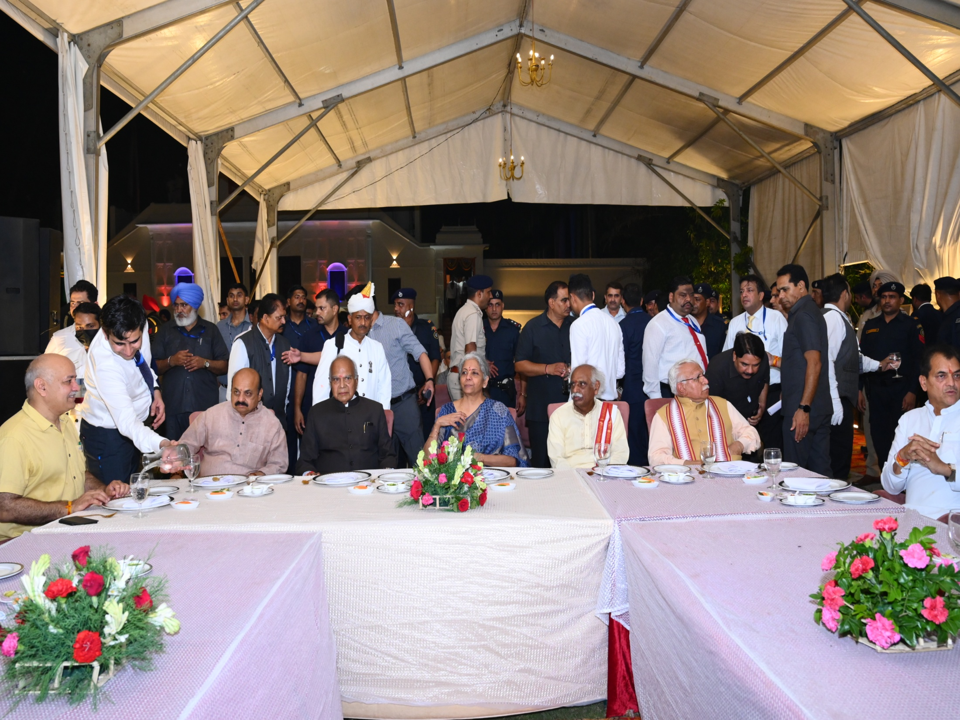
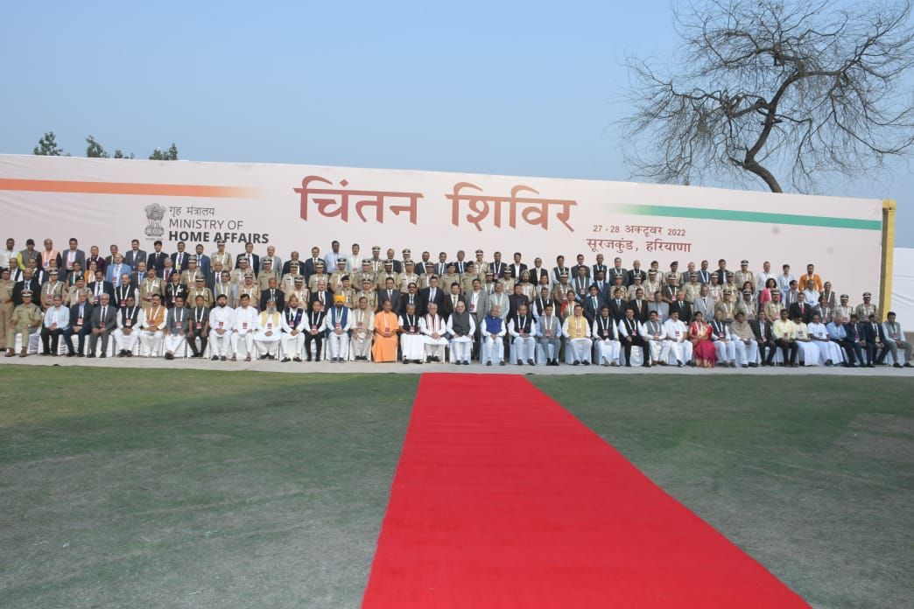
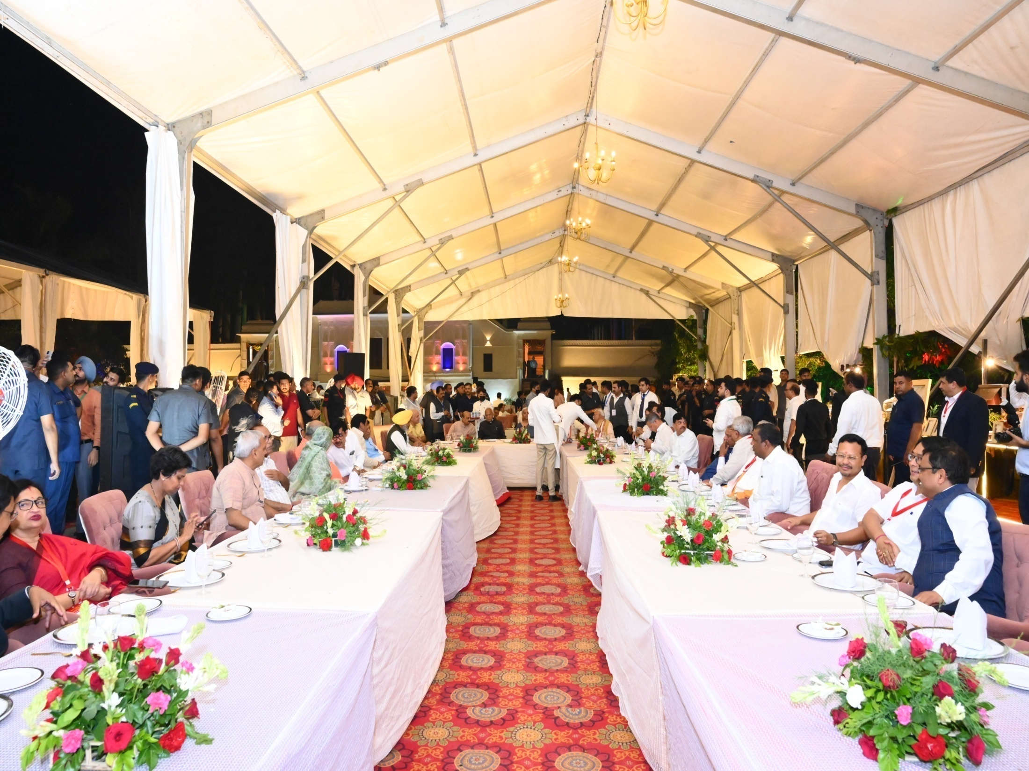
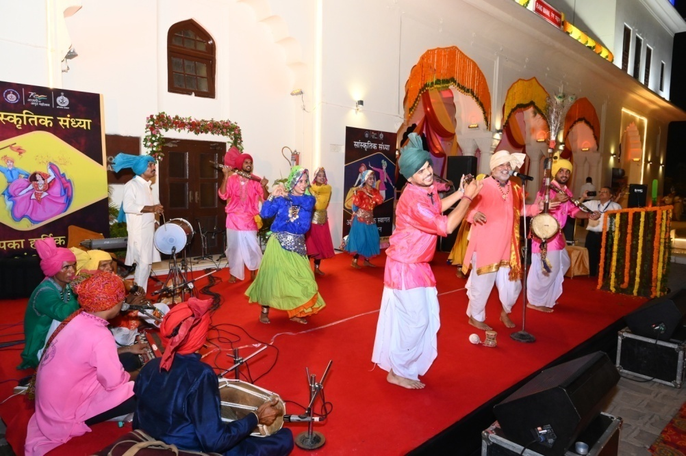
Major MICE Activities Held in Haryana
47th national Conference of GST at Yadavindra Gardens, Pinjore
The concluding session of the 47th meeting of the Goods and Services Tax (GST) Council, chaired by Union Finance Minister Nirmala Sitharaman was organised at the royal Yadavindra Gardens, Pinjore on 29 June, 2022.
Chintan Shivir, October, 2022 at Surajkund Haryana
Haryana Tourism Corporation hosted 2022 Chintan Shivir session at Rajhans Tourist Complex Convention space in Surajkund, Faridabad

Slide 9
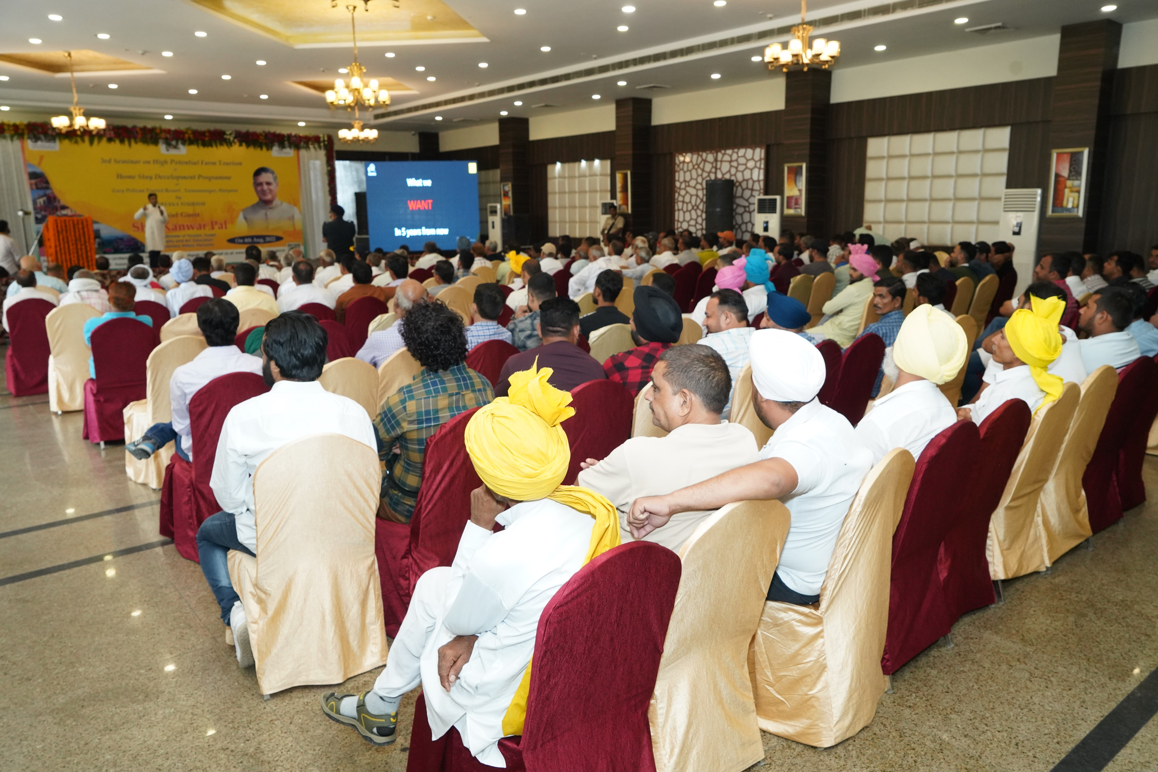
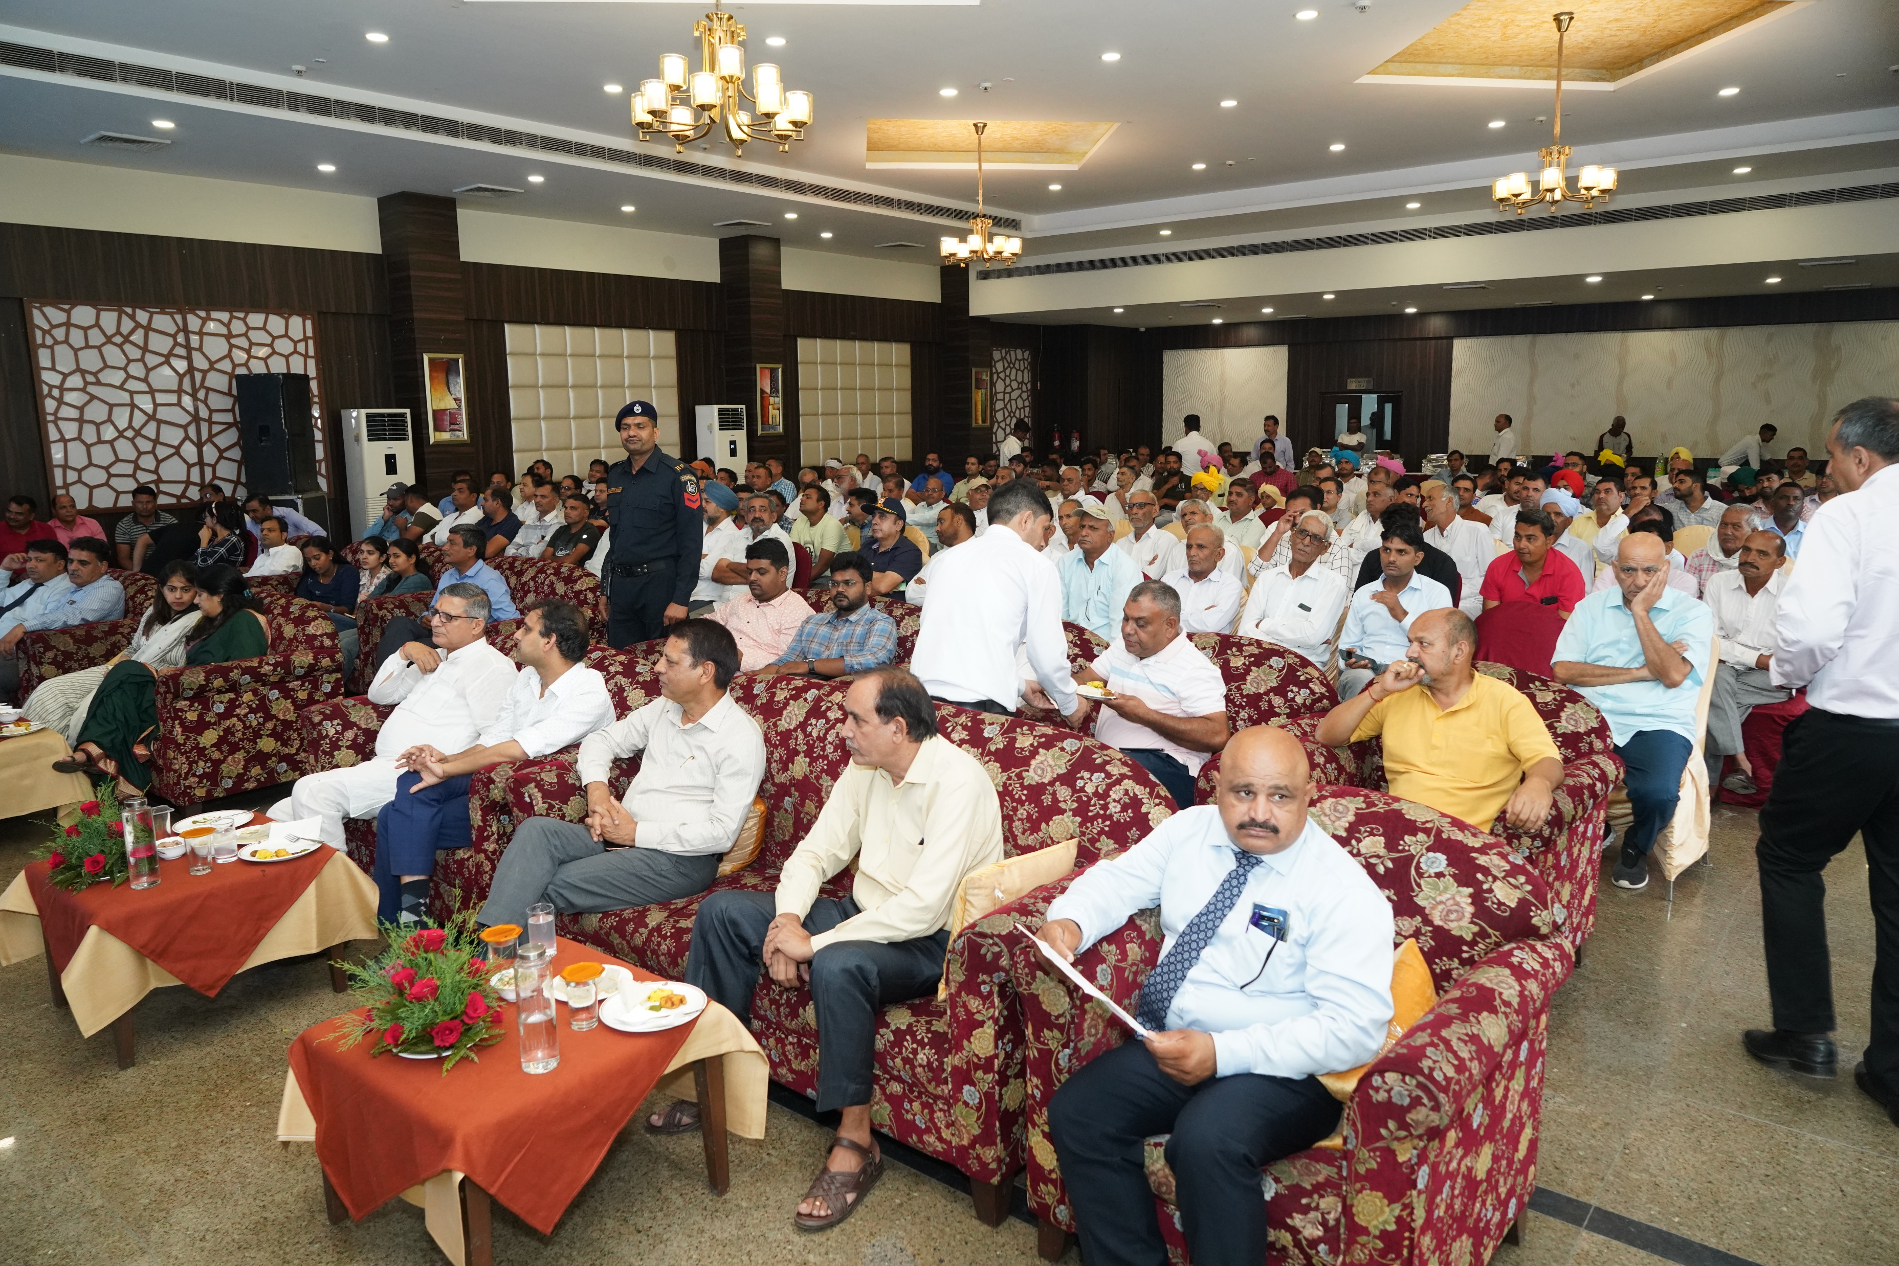
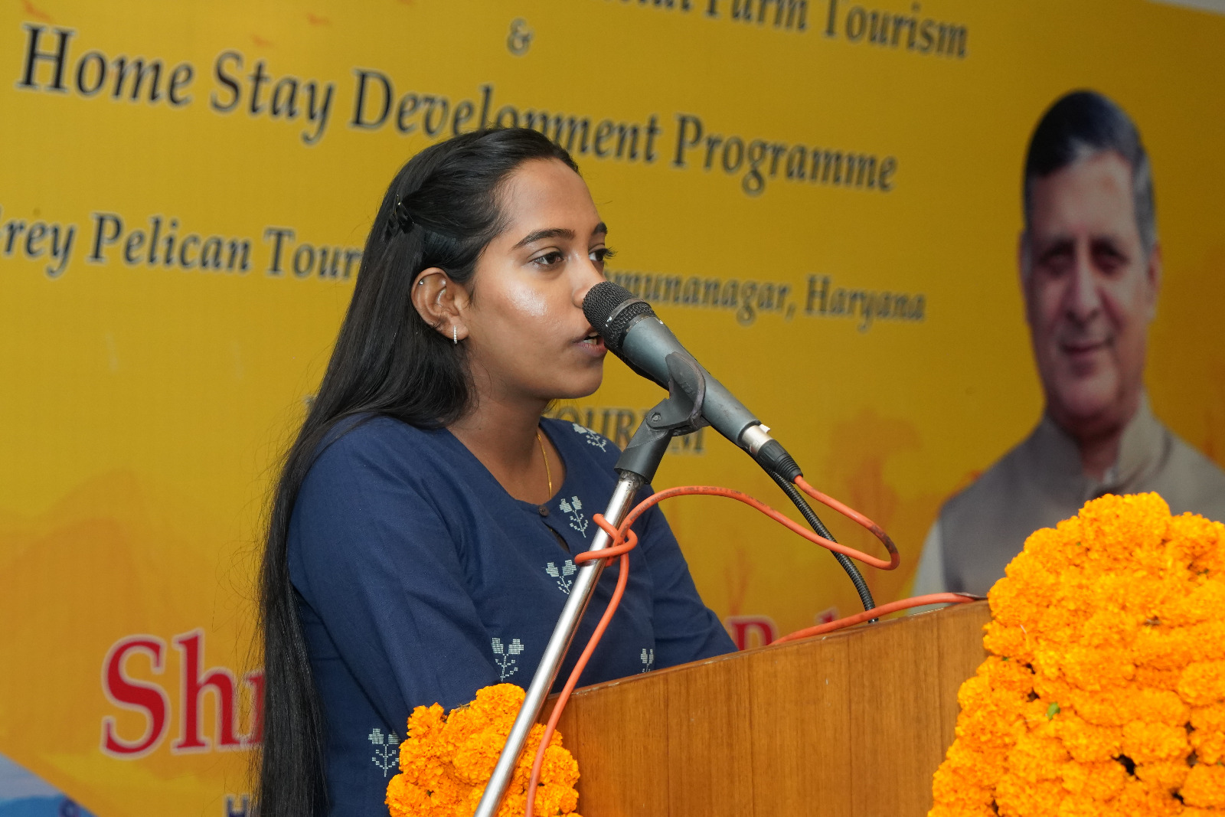
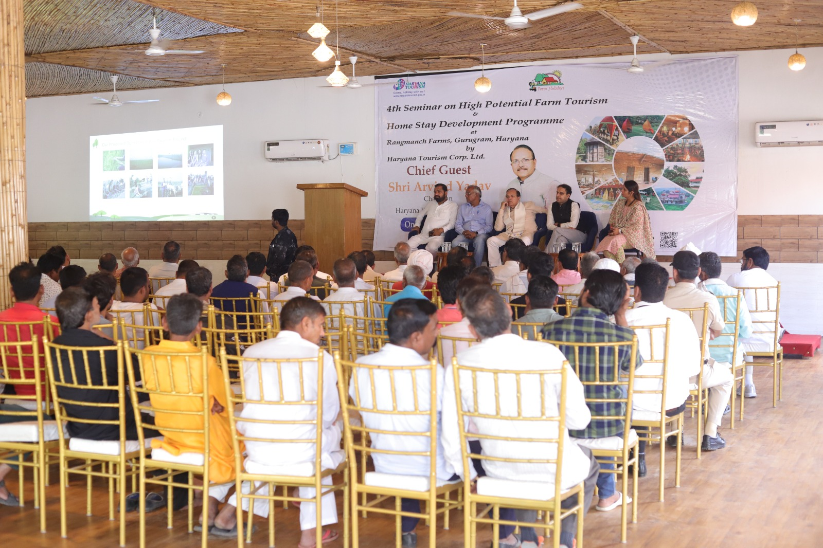
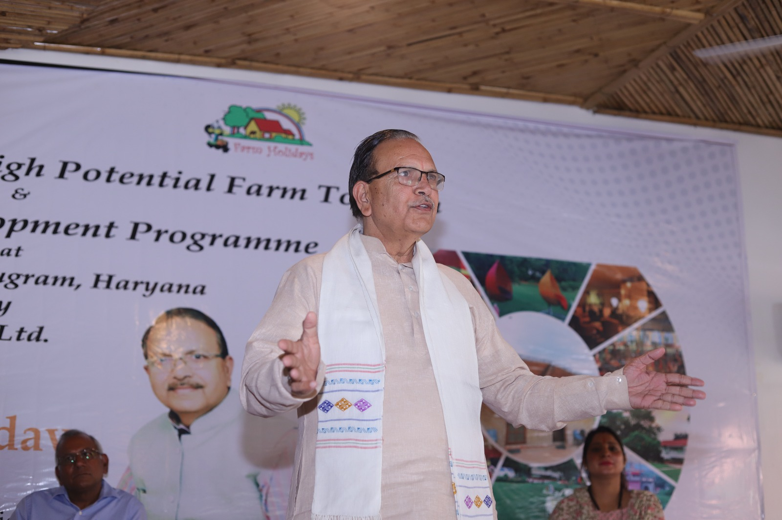
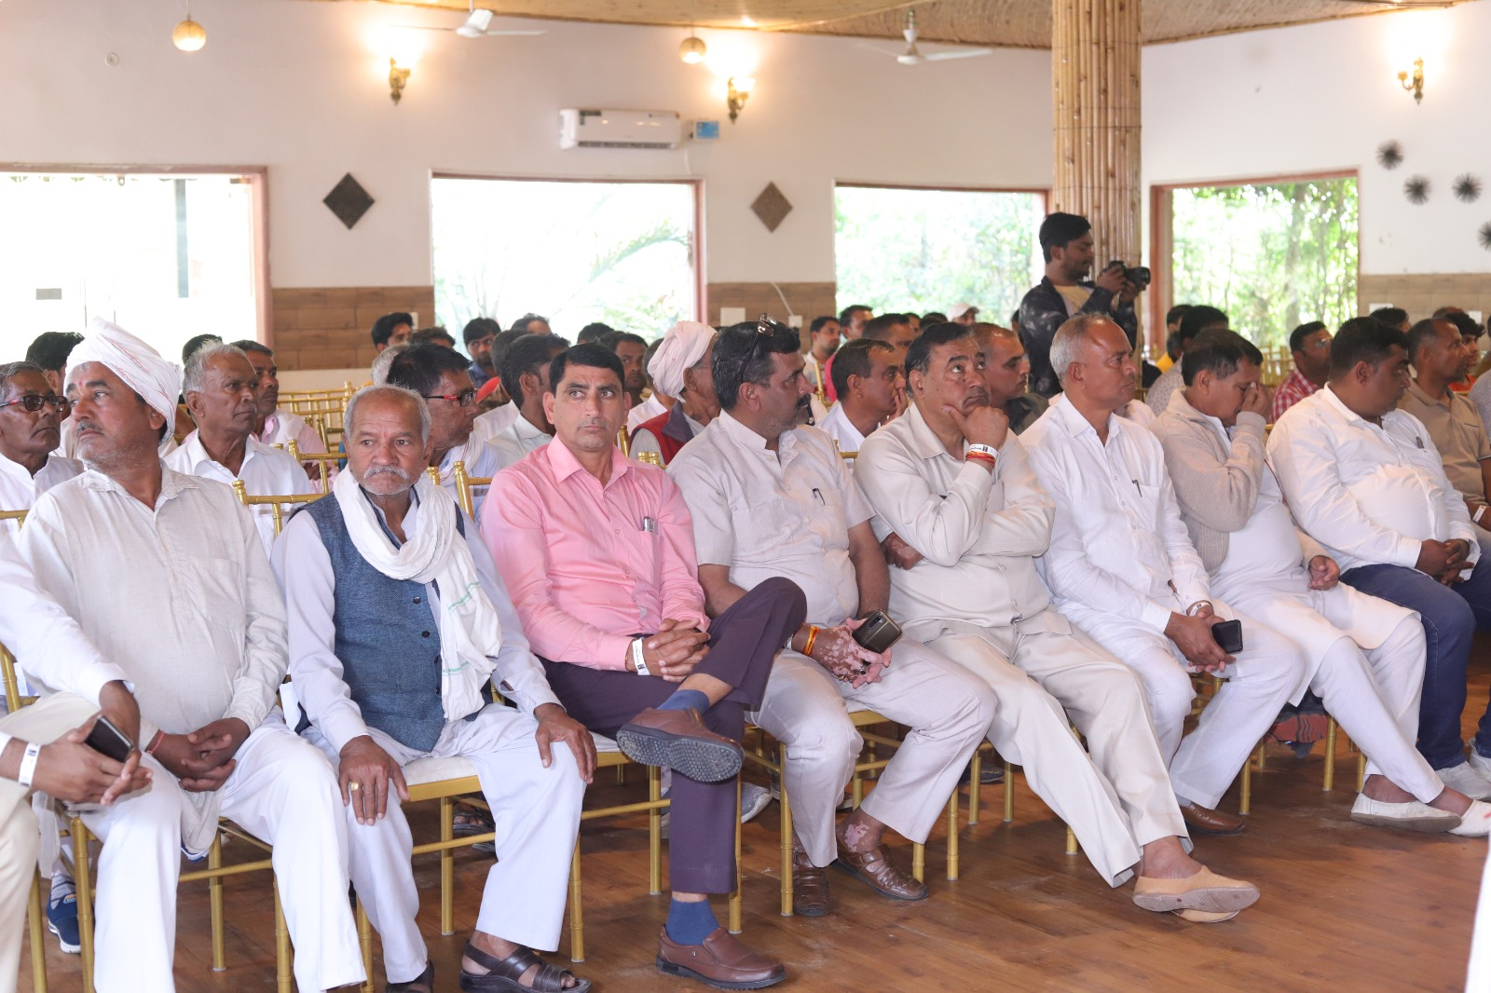
Conferences / Seminars for Promoting Homestay and Farm Tourism in the state
Seminars on high potential Farm Tourism and home stay development programme held at various destinations of Haryana

Slide 10
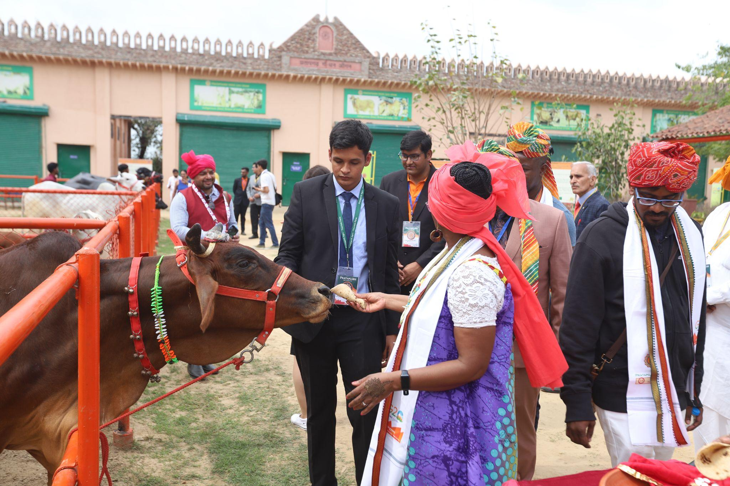
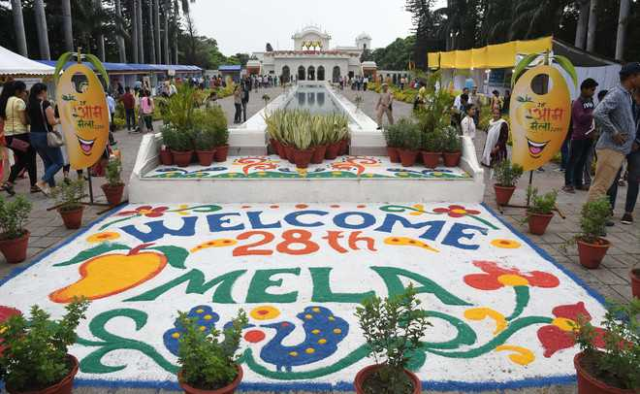
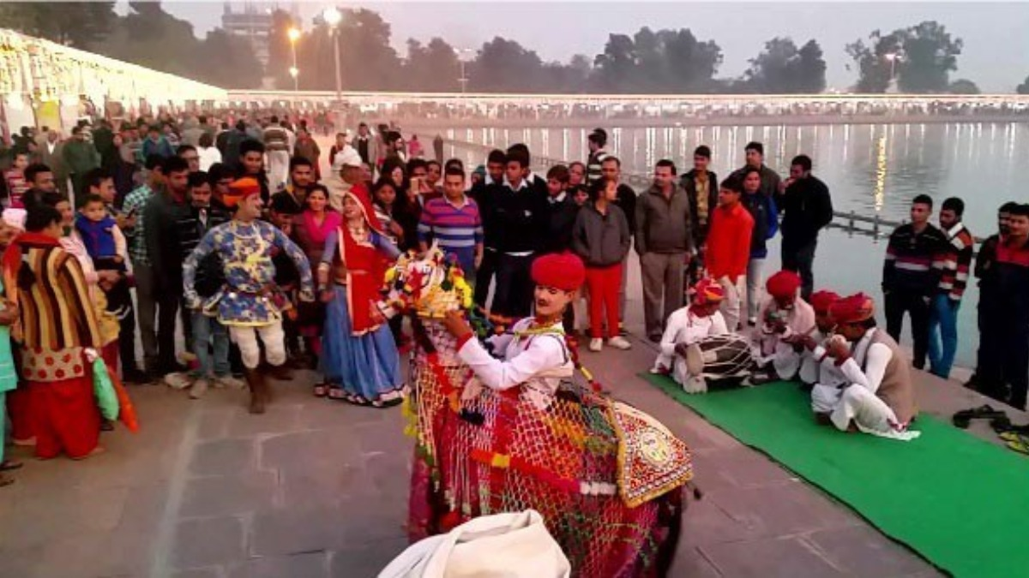
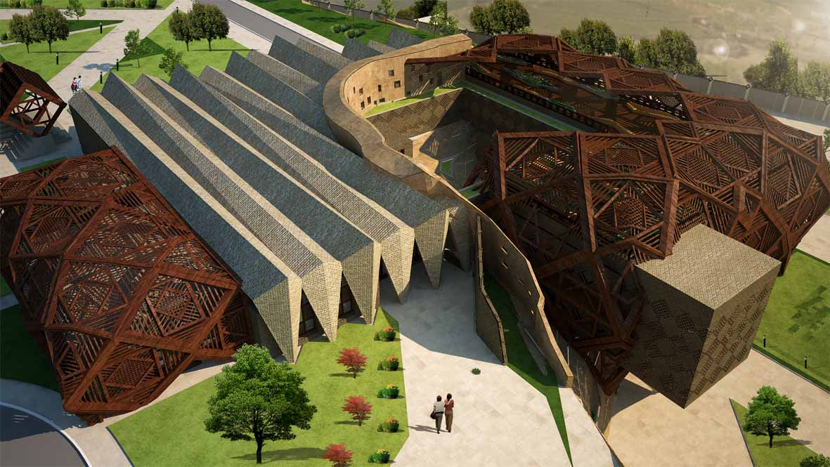
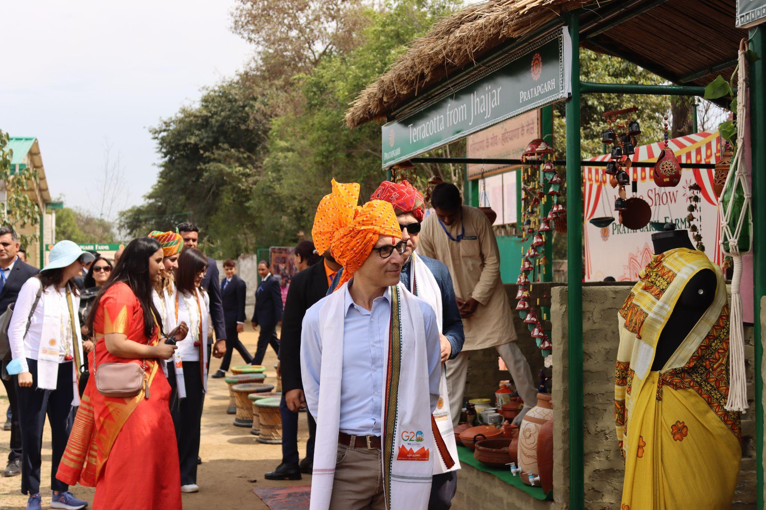
Other ancillary MICE activities in Haryana
Associations
Cultural MICE Tourism
Destination Centric and Religious
International Gita Mahotsav at Kurukshetra hosts world class religious mela which attracts footfalls upto 40 + lakhs
Mango Festival (platform for local producers of mangos and international traders and consumers of mangos to interact and network within one single event.
Organizing Various seminars and workshops in farm Tourism Destinations of Haryana
Newly Constructed Brahma Sarovar, Sannihit Sarovar, Pipli Complex and Kurukshetra Convention centers
Hisar Utsav (Celebrates Hisar traditions and culture, conference and seminars and workshops on Hisar’s history traditions and culture.
Aravali Golf Course at Faridabad has been a platform for global sports and golfing events, training sessions
Hosting G20 Delegates at Pratapgarh Farms, Jhajjar

Slide 11
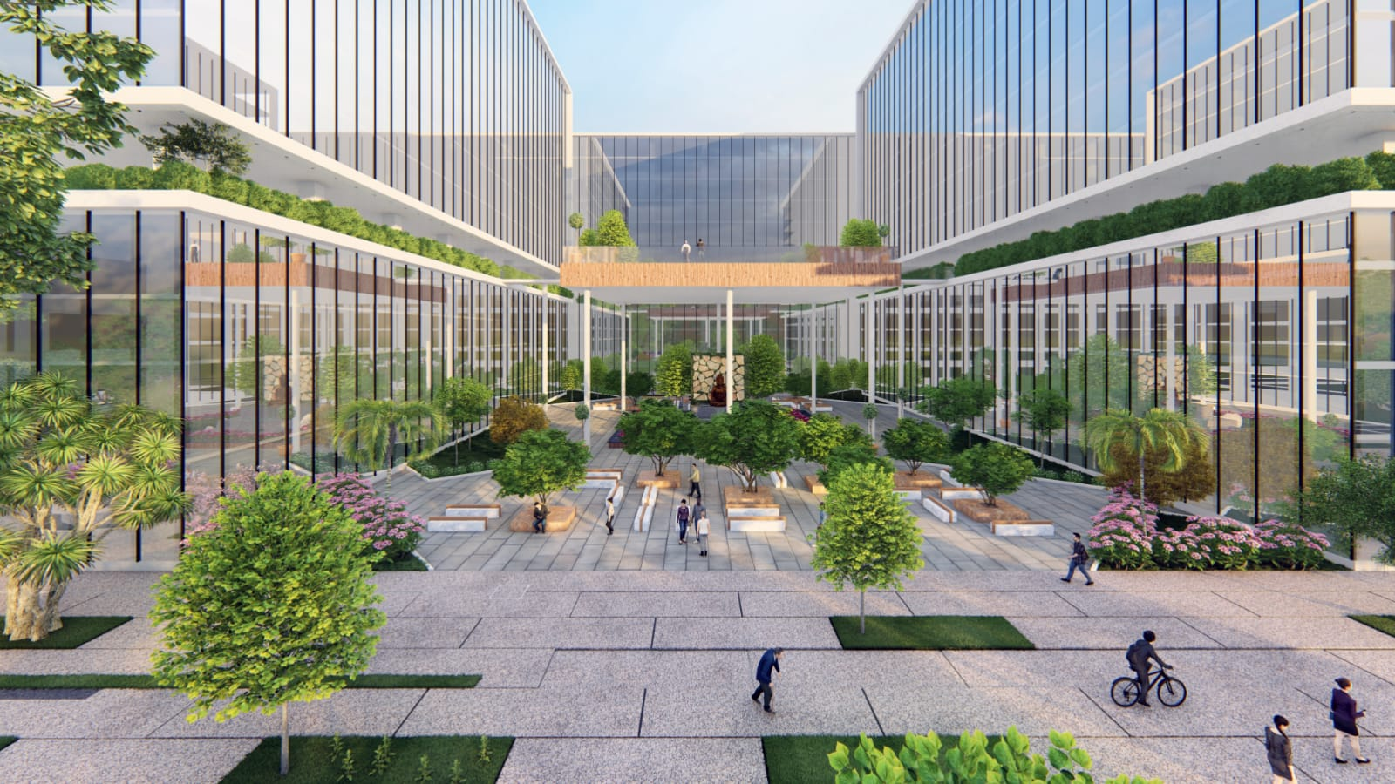
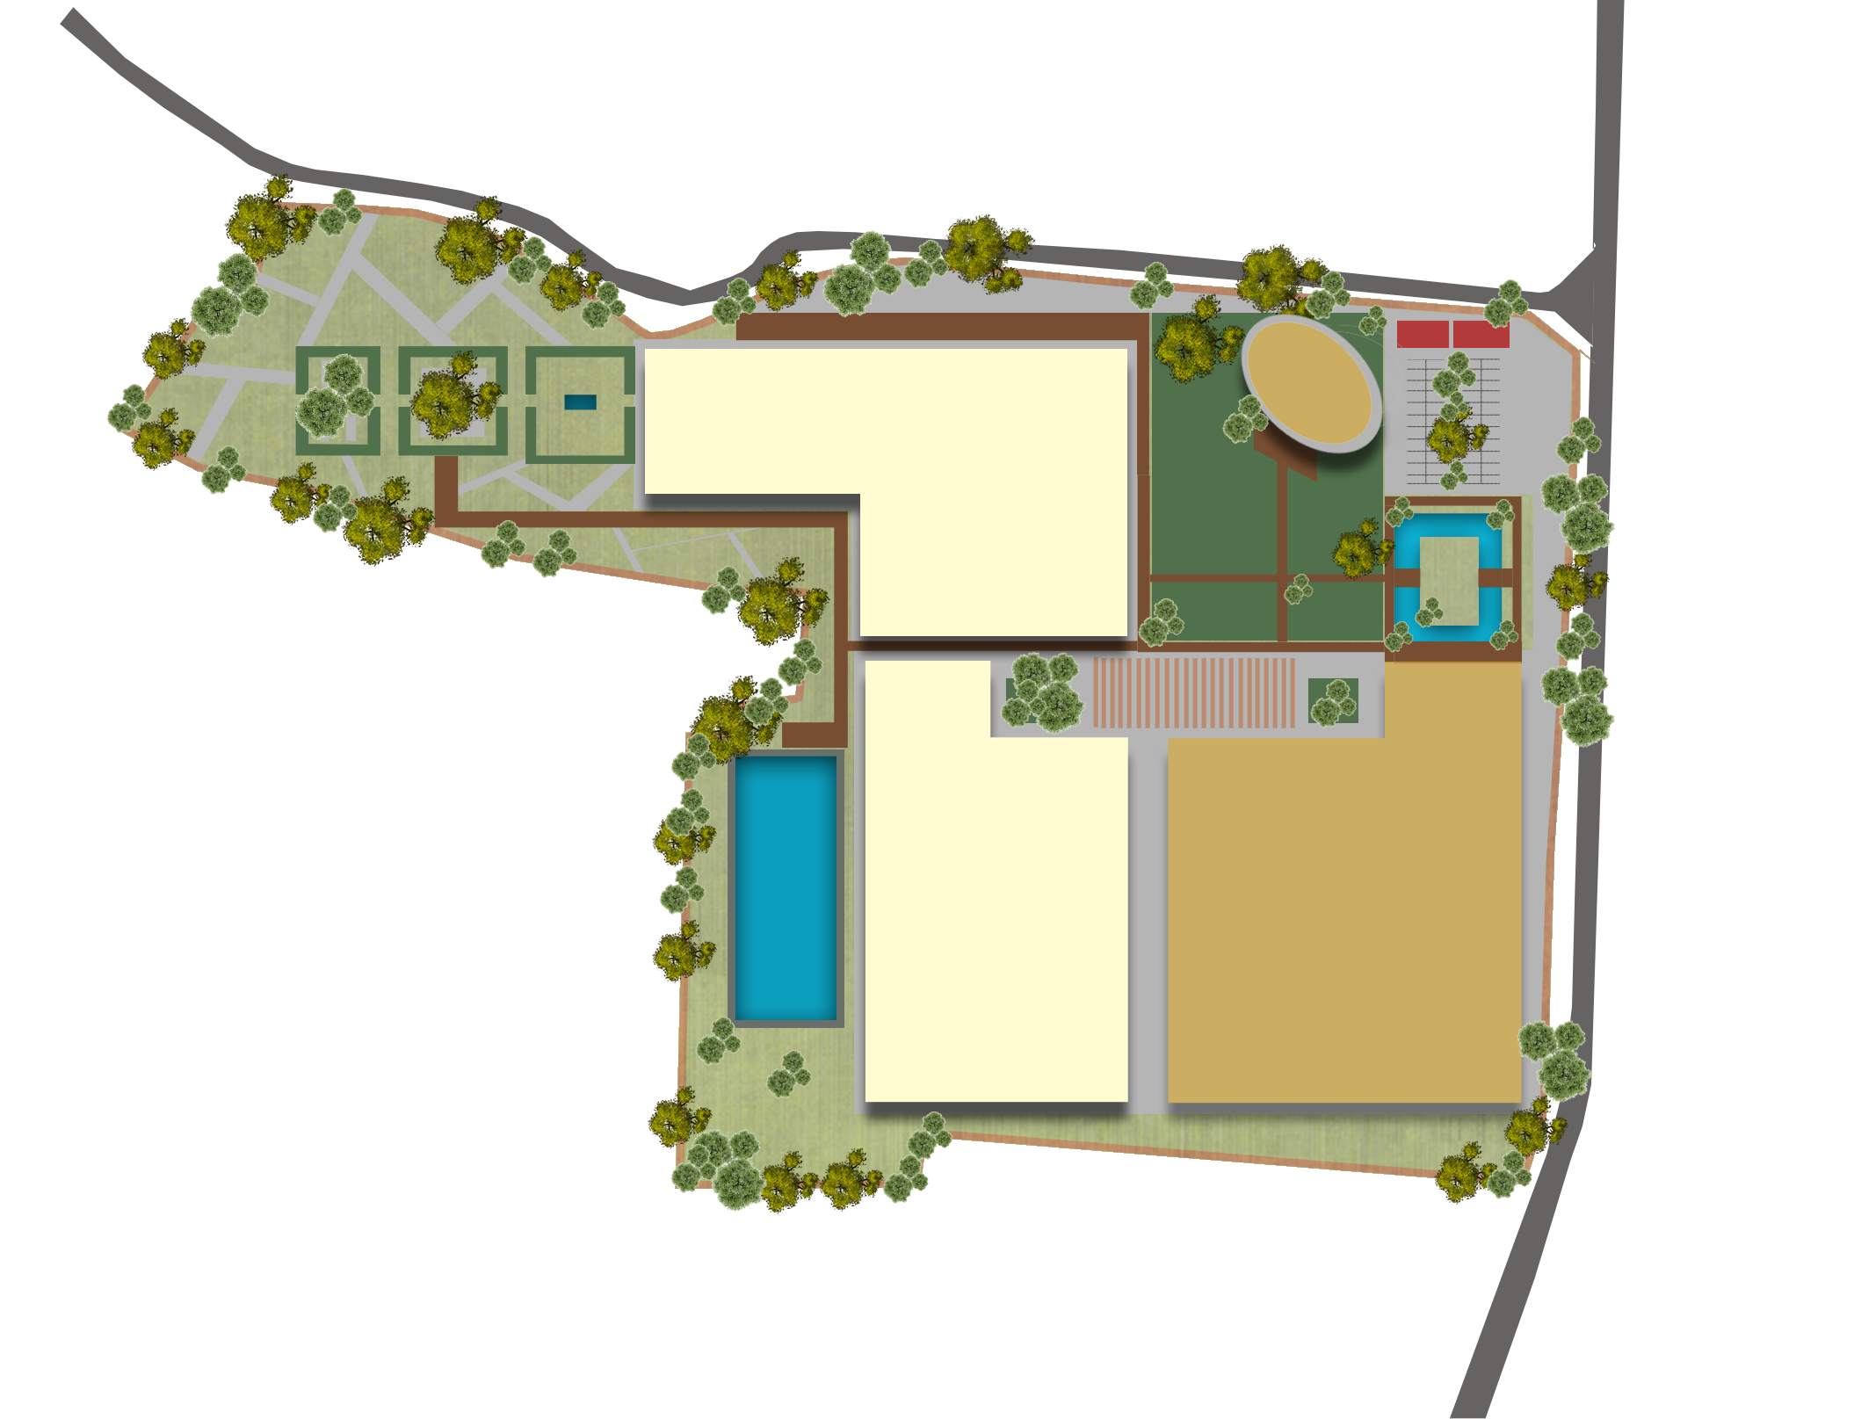
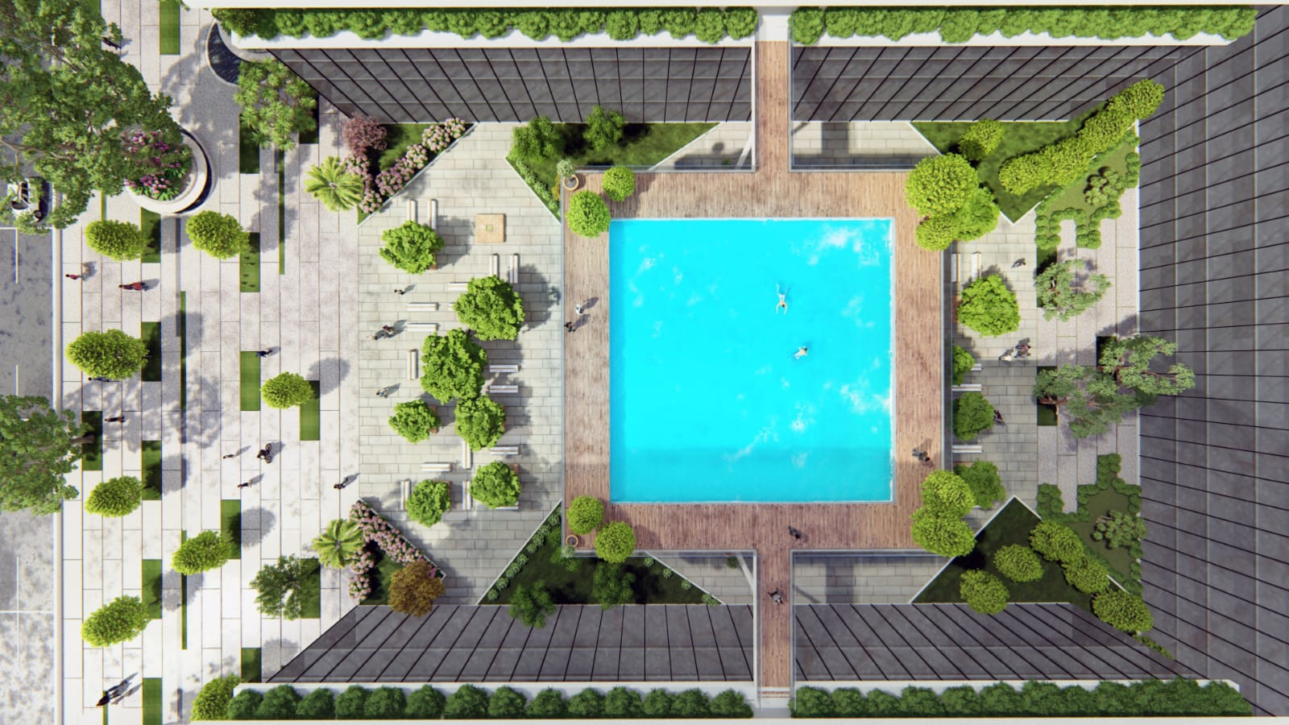
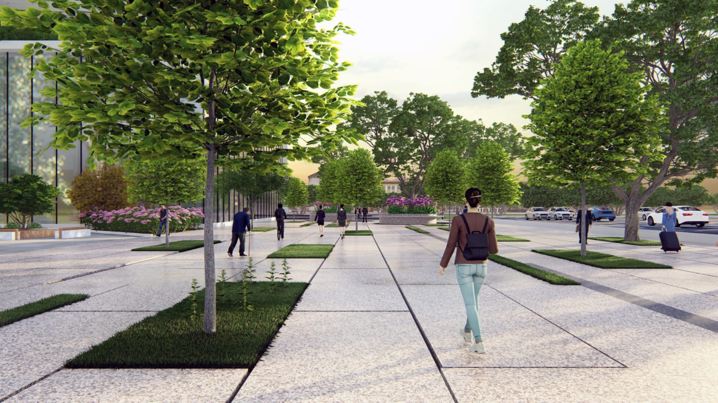
Upcoming Projects
Development of World class Convention center along with 500 key 5 star hotel property at Surajkund Faridabad
Levelled Garden and Open Event Space
8,000 Sqm
Convention Grounds
8,000 Sqm
Driver’s resting
Auditorium
Restaurant and Hotel
5, 000Sqm
Parking
10, 000 Sqm
Entrance plaza and Dropoff area
Swimming Pool
Way to Basement Parking
Area Statement
Component | Area (Sqm)
Convention center | 15,000
Business center and Hotel block 1 | 8,000
Restaurant and Hotel block 2 | 10,000
Auditorium | 5,000
Convention Grounds | 8,000
Leveled Garden and event space | 8,000
Roof top Convention space | 10,000
Business Center and Hotel
Convention center
Convention Roof
Top Garden
10,000 Sqm
8, 000 Sqm
15, 000 Sqm
Parabola structure
Total Built up of 38,000 Sqm
70 Cars Outdoor
1000+ Cars Indoor

Slide 12
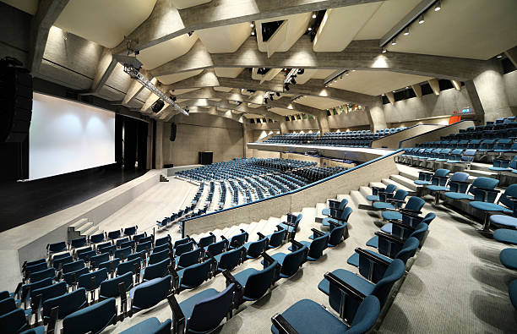
Thank You…

Slide 13
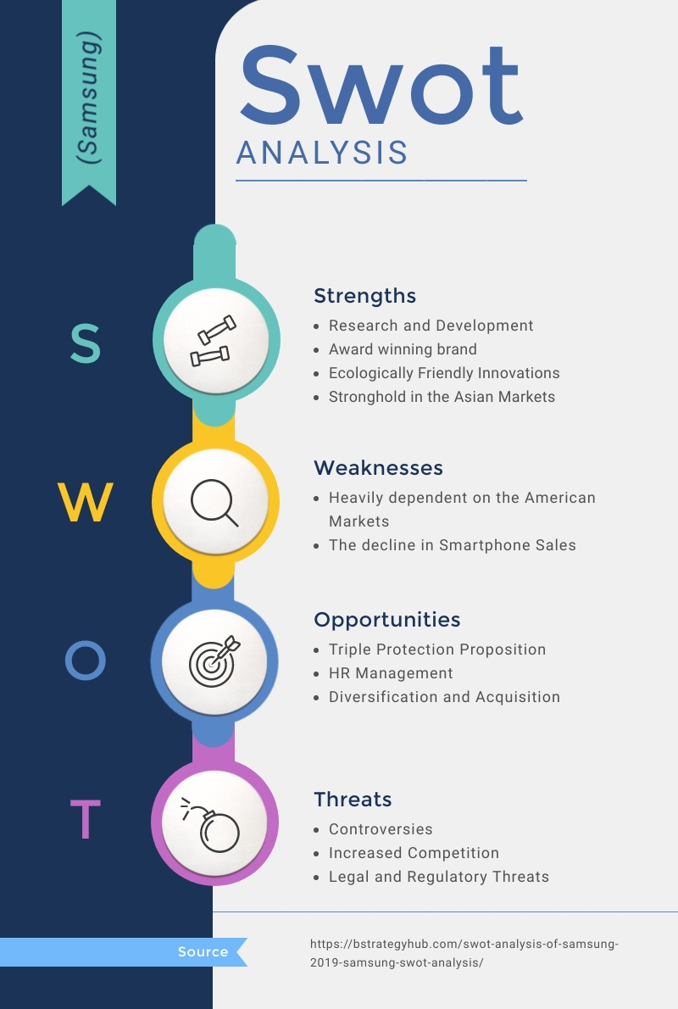
`
Advantages of MICE Tourism in India
SWOT Analysis
Contribution to employment and income, nationally and regionally.
Increasing no. of. MICE venues/ convention centers in India
India’s varied aesthetic and natural beauty
Availability of Infrastructure
Emergence of better investment climate
Educated and skilled manpower
Growing Economic Strength of India
Increased foreign exchange earnings for a nation.
Generation of investment in tourism/ infrastructure recreation.
Stimulation of business activity within and between the nations. Providing opportunities to promote national interest and international co-operation.
Lack of focused approach on MICE as an industry
Lack of proper information, intelligence
High Tax Structure and Costs
Standardization of processes and services for every touchpoint of MICE
Lack of institutional support
Provision of opportunities for access to new technology, exchange of ideas.
Make in India, Start Up India, Tax reforms to spruce up investment scenario
Government focus on ease of business and promotion of tourism
Emergence of Asia Pacific in MICE events
Draws together leading national and international specialists and practitioners in their fields.
Stabilisation of tourism inflows to a nation and its sub-regions
Regional Competition from Singapore, Thailand, mainland China, Macau, Malaysia
Less identification as Safe and secure location as India ranked 122 in Safety and security
Effective marketing tools for attracting new business and visitors to an area
Provision of local tourism operators with useful advanced knowledge of visitor numbers to plan accordingly the future financials

Slide 14
Global Footprint of MICE Tourism as per ICCA Ranking
Canada
Rank: 10
No.of Meetings- 315
Sweden
Rank: 10
No.of Meetings- 315
CHINA
Rank: 08
No.of Meetings- 449
United Kingdom
Rank: 05
No.of Meetings- 574
Germany
Rank: 02
No.of Meetings- 642
Republic of Korea
Rank: 12
No.of Meetings- 273
Ireland
Rank: 30
No.of Meetings- 146
Italy
Rank: 06
No.of Meetings- 522
France
Rank: 04
No.of Meetings- 579
USA
Rank: 1
No.of Meetings- 947
Japan
Rank: 07
No.of Meetings- 492
Spain
Rank: 03
No.of Meetings- 595
Mexico
Rank: 24
No.of Meetings- 172
Australia
Rank: 13
No.of Meetings- 265
Columbia
Rank: 29
No.of Meetings- 147
India
Rank: 28
No.of Meetings- 128
Brazil
Rank: 17
No.of Meetings- 233
India has improved its position substantially in the recent times, when it hosted 128 meetings in 2018-19 compared to 92 for the previous year, thus leaping and improving its position by seven positions from 35 in last year
Major global MICE events in India: Jaipur Literature festival, Auto Expo, Indian International Trade Fair, Surajkund Mela, Impex India International Trade Fair
Source: The International Congress and Convention Association (ICCA)

Slide 15
MICE Destinations in India
1300+
Top Performing
Fast Emerging
Laggard with Potential
Star category hotel capable of being excellent venue for MICE Tourism
Delhi NCR (Gurgaon, Faridabad)
Maharashtra Tamil Nadu Karnataka
Rajasthan Uttar Pradesh Gujarat Andhra Pradesh
Kerala
Odisha
Telangana
West Bengal
Jharkhand Madhya Pradesh
Assam
70+
Convention centers each having the possibility of hosting the world-class events
MICE Cities with Compounded Average Growth Rate for 5 year period from 2016-21
Government Initiatives to Promote MICE Tourism
Formation of India Convention Promotion Bureau (ICPB) in 1988 for the development of the Indian MICE industry
NCR
Bangalore
CAGR- 13.9%
CAGR- 14.5%
In June 2021, the Ministry of Tourism has identified Agra, Udaipur, Pune, Thiruvananthapuram, Varanasi, and Bhubaneshwar for prioritizing MICE Tourism in India in these Cities
Mumbai
Chennai
CAGR- 3.7%
CAGR- 9.3%
Karnataka CM in March, 2022 announced upgradation of Bangalore to world class MICE destination
Goa
Hyderabad
Upgradation works carried out in Pragati Maidan, New Delhi to make it the most modern exhibition and convention center in the Country
CAGR- 4.7%
CAGR- 8.0%
Source: Journal of Tourism and Hospitality: MICE tourism in India, Future Trends and Challenges by Jitendar Singh
India is part of BRICS and handling G20 presidency in 2022-23.

